Slide 1


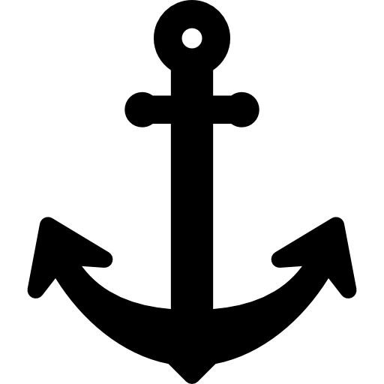
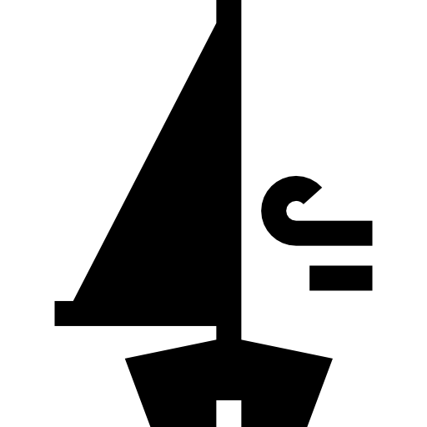

Two rudders
Place anchor before the Raft part
Sail direction
Sail direction
Place anchor before the Raft part

